Slide 1
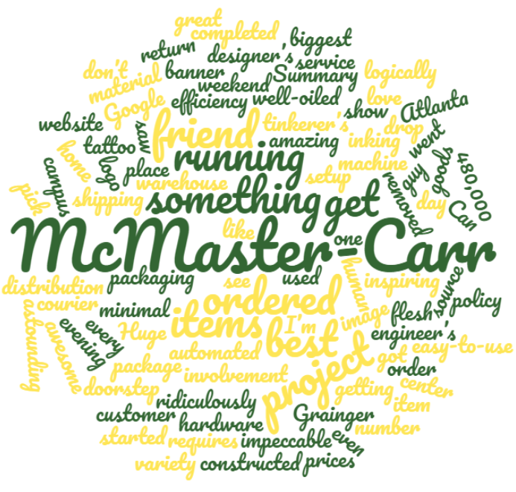
Sentiment Analysis
Alexander Booth
1/25/18

Slide 2
Itinerararary
What is Sentiment
Challenges of Sentiment Analysis
Basic Sentiment Analysis (Lexicon)
SA in R
Case Study #1: Jane Austen
Case Study #2: Bee Movie
SA in Python
SA and Machine Learning: The Naïve Bayes Classifier
Case Study #3: Tweets

Slide 3
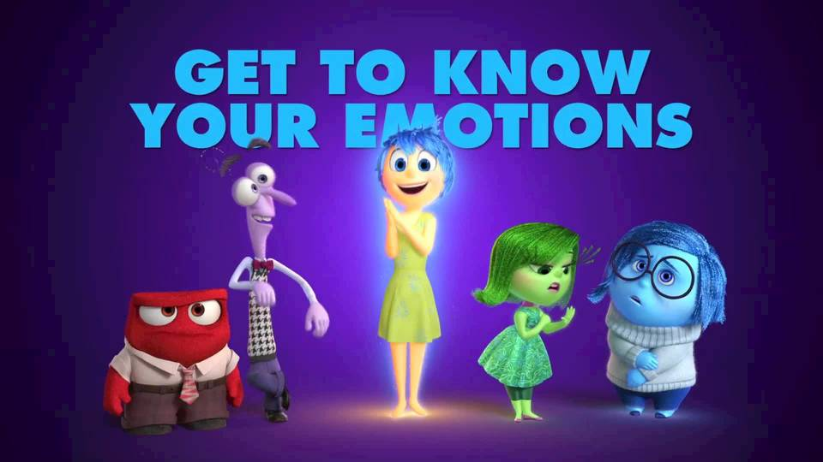
Notes:
Sentiment = feelings

Slide 4
How do people feel?
Moods
Emotions
Opinions
*Subjective impressions, not facts*
Notes:
Generally, a binary opposition in opinions is assumed ● For/against, like/dislike, good/bad, etc

Slide 5
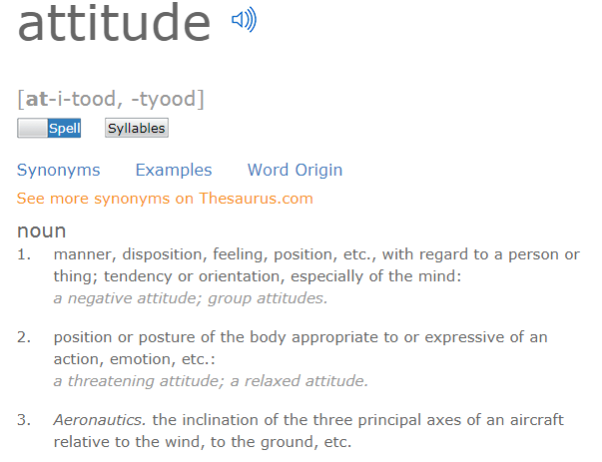
Notes:
Sentiment analysis is the detection of attitudes

Slide 6
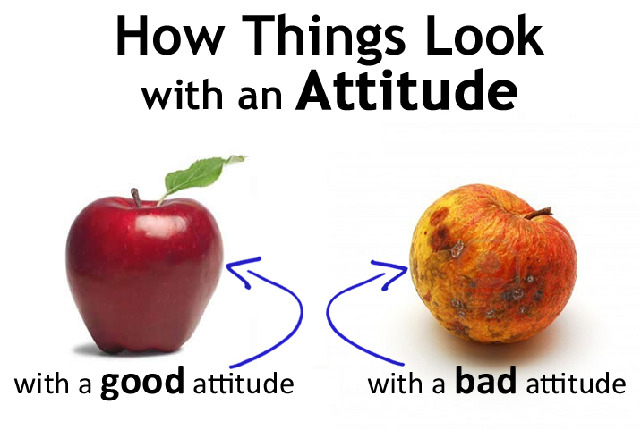
Notes:
4 Parts:
Holder or source
Target
Type or Polarity
Love, Hate, Ambivalent
Positive, Negative, Neutral
Text containing the attitude
Sentiment analysis involves the detection of all of them

Slide 7
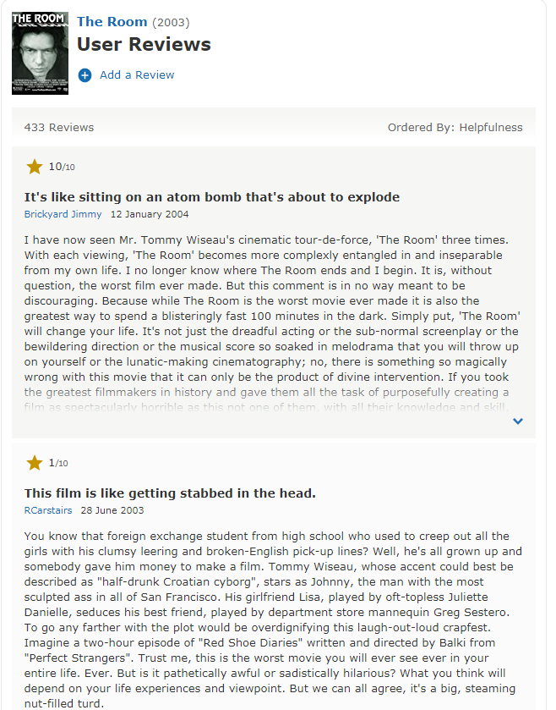
Notes:
Positive or negative movie review? Binary. Strong opinions

Slide 8

What is Sentiment Analysis?
“Using Natural Language Processing (NLP), statistics, or machine learning methods to extract, identify, or otherwise characterize the sentiment content of a text unit.”
Notes:
What is sentiment analysis? definition

Slide 9

A Rose By Any Other Name…
Opinion Mining
Opinion Extraction
Sentiment Mining
Subjectivity Analysis
Polarity Determination
Text Analysis
Notes:
Sentiment analysis has many other names

Slide 10

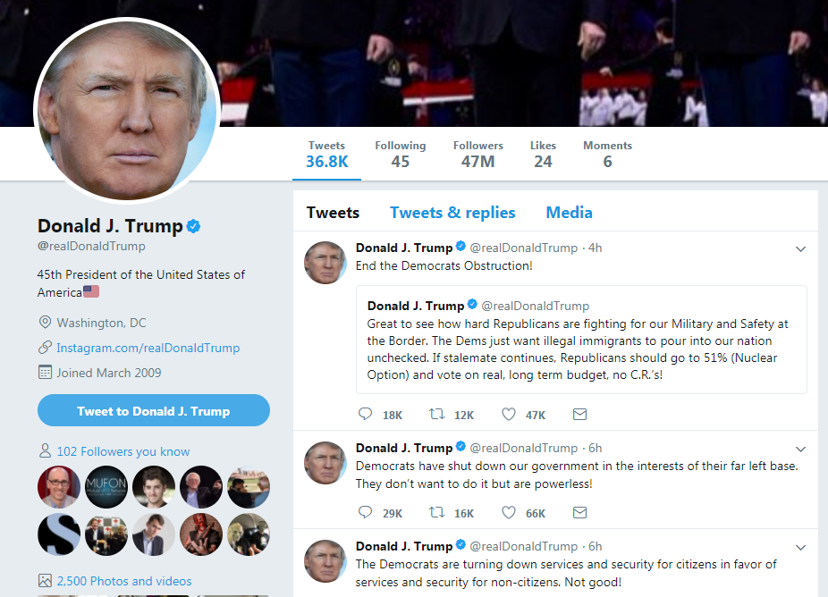
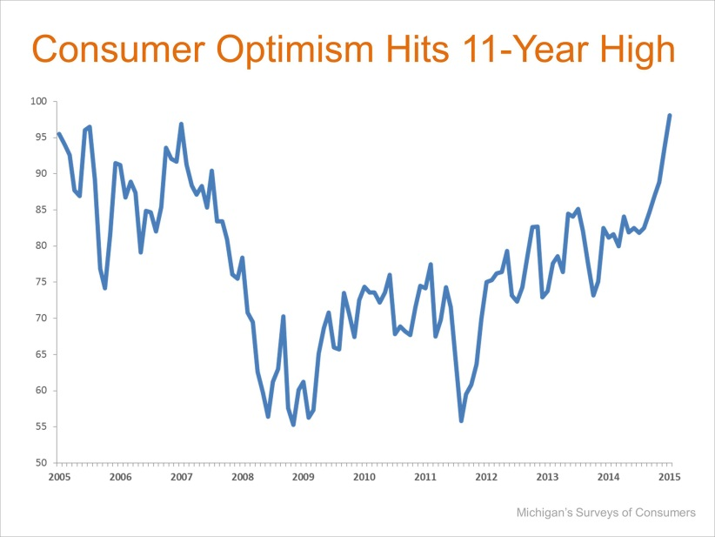


Notes:
Some uses of sentiment analysis:
Movie: is this review positive or negative? • Products: what do people think about the new iPhone? • Public sentiment: how is consumer confidence? Is despair increasing? • Politics: what do people think about this candidate or issue? • Prediction: predict election outcomes or market trends from sentiment

Slide 11
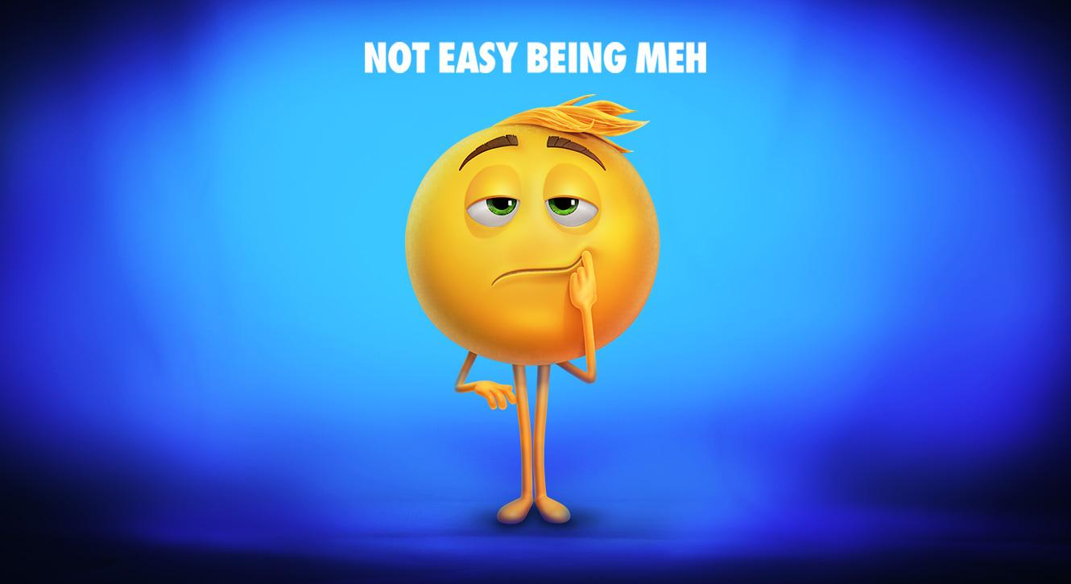
Notes:
Challenges with Sentiment Analysis
● People express opinions in complex ways ● In opinion texts, lexical content alone can be misleading ● Intra-textual and sub-sentential reversals, negation, topic change common ● Rhetorical devices/modes such as sarcasm, irony, implication, etc.

Slide 12

Dear McMaster-Carr,
Yesterday, I had occasion to purchase industrial supplies from Grainger. They had an excellent selection, friendly and helpful salespeople, and the lowest prices in town.
You guys suck.
Sincerely,
I <3 Grainger
Notes:
This sounds like a positive email, but it isn’t

Slide 13
Basic Sentiment Analysis: Or How I Learned to Stop Worrying And Love the Lexicon

Slide 14
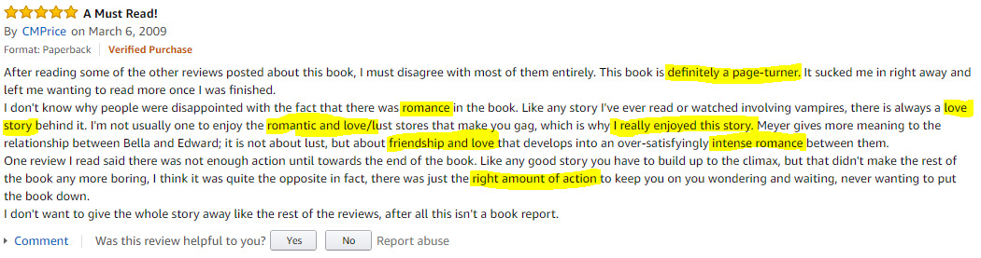

Slide 15
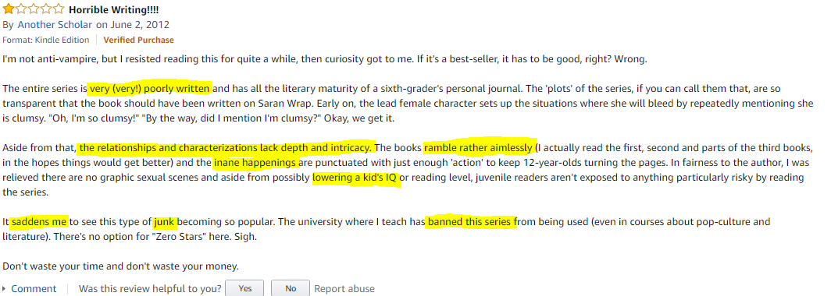
Notes:
Natural lexicon
● Texts are made up of words ● Words are in dictionaries ● Let's look up the words in the text, see what they mean, and be done with it!

Slide 16

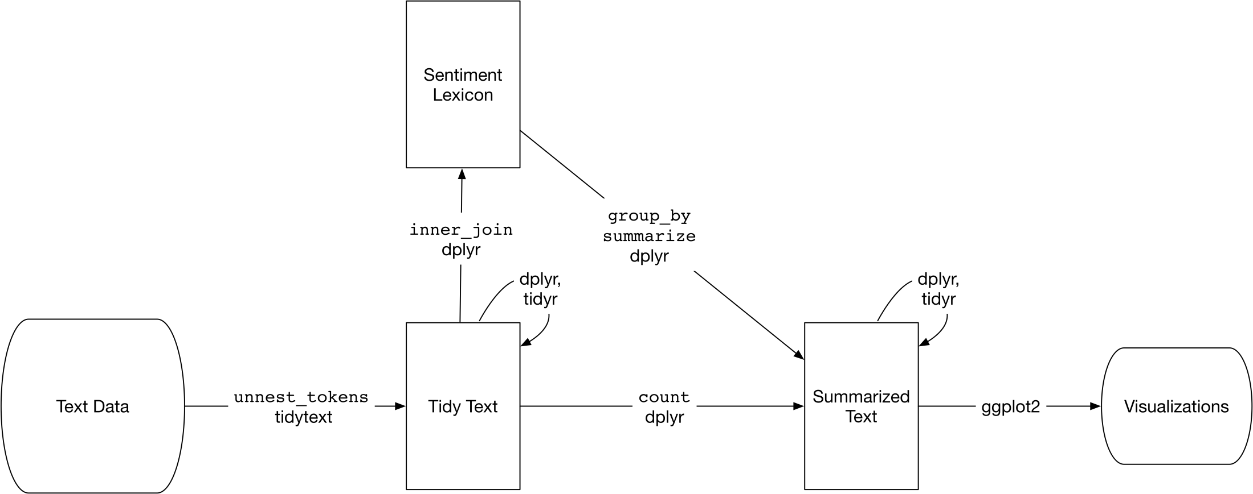
Notes:
One way to analyze the sentiment of a text is to consider the text as a combination of its individual words and the sentiment content of the whole text as the sum of the sentiment content of the individual words. This isn’t the only way to approach sentiment analysis, but it is an often-used approach, and an approach that naturally takes advantage of the tidy tool ecosystem.

Slide 17

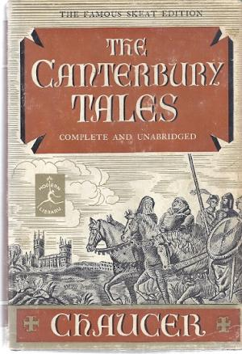
Notes:
How were these sentiment lexicons put together and validated? They were constructed via either crowdsourcing (using, for example, Amazon Mechanical Turk) or by the labor of one of the authors, and were validated using some combination of crowdsourcing again, restaurant or movie reviews, or Twitter data. Given this information, we may hesitate to apply these sentiment lexicons to styles of text dramatically different from what they were validated on, such as narrative fiction from 200 years ago.

Slide 18
Lexicon Warnings
Old literature will be skewed
Most are unigrams (single words) so negation like “no good” or “not true” are treated as two words
Most English words are pretty neutral
Size of the chunk of text matters
Notes:
Not every English word is in the lexicons because many English words are pretty neutral. It is important to keep in mind that these methods do not take into account qualifiers before a word, such as in “no good” or “not true”; a lexicon-based method like this is based on unigrams only. For many kinds of text (like the narrative examples below), there are not sustained sections of sarcasm or negated text, so this is not an important effect. Also, we can use a tidy text approach to begin to understand what kinds of negation words are important in a given text; see Chapter 9 for an extended example of such an analysis.
One last caveat is that the size of the chunk of text that we use to add up unigram sentiment scores can have an effect on an analysis. A text the size of many paragraphs can often have positive and negative sentiment averaged out to about zero, while sentence-sized or paragraph-sized text often works better.

Slide 19


Slide 20
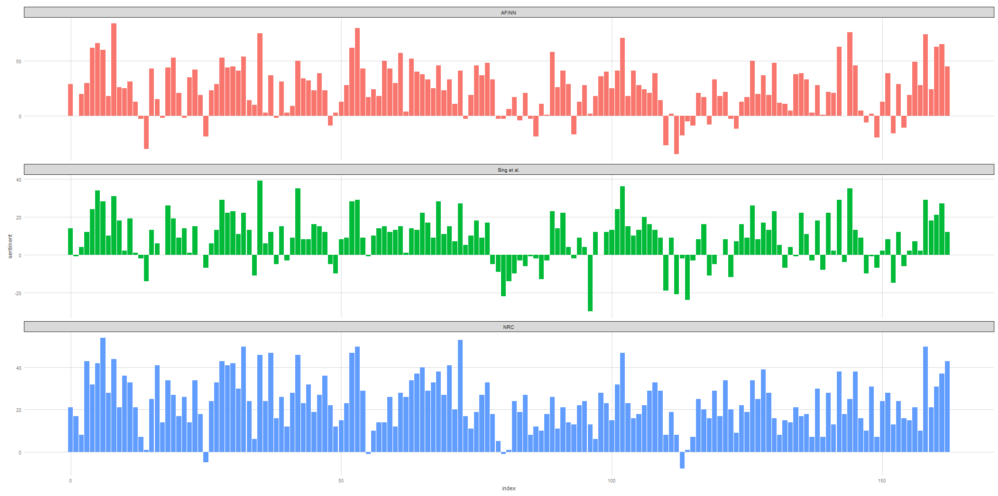
Notes:
Pride and Prejudice sentiment comparison across Lexicons

Slide 21
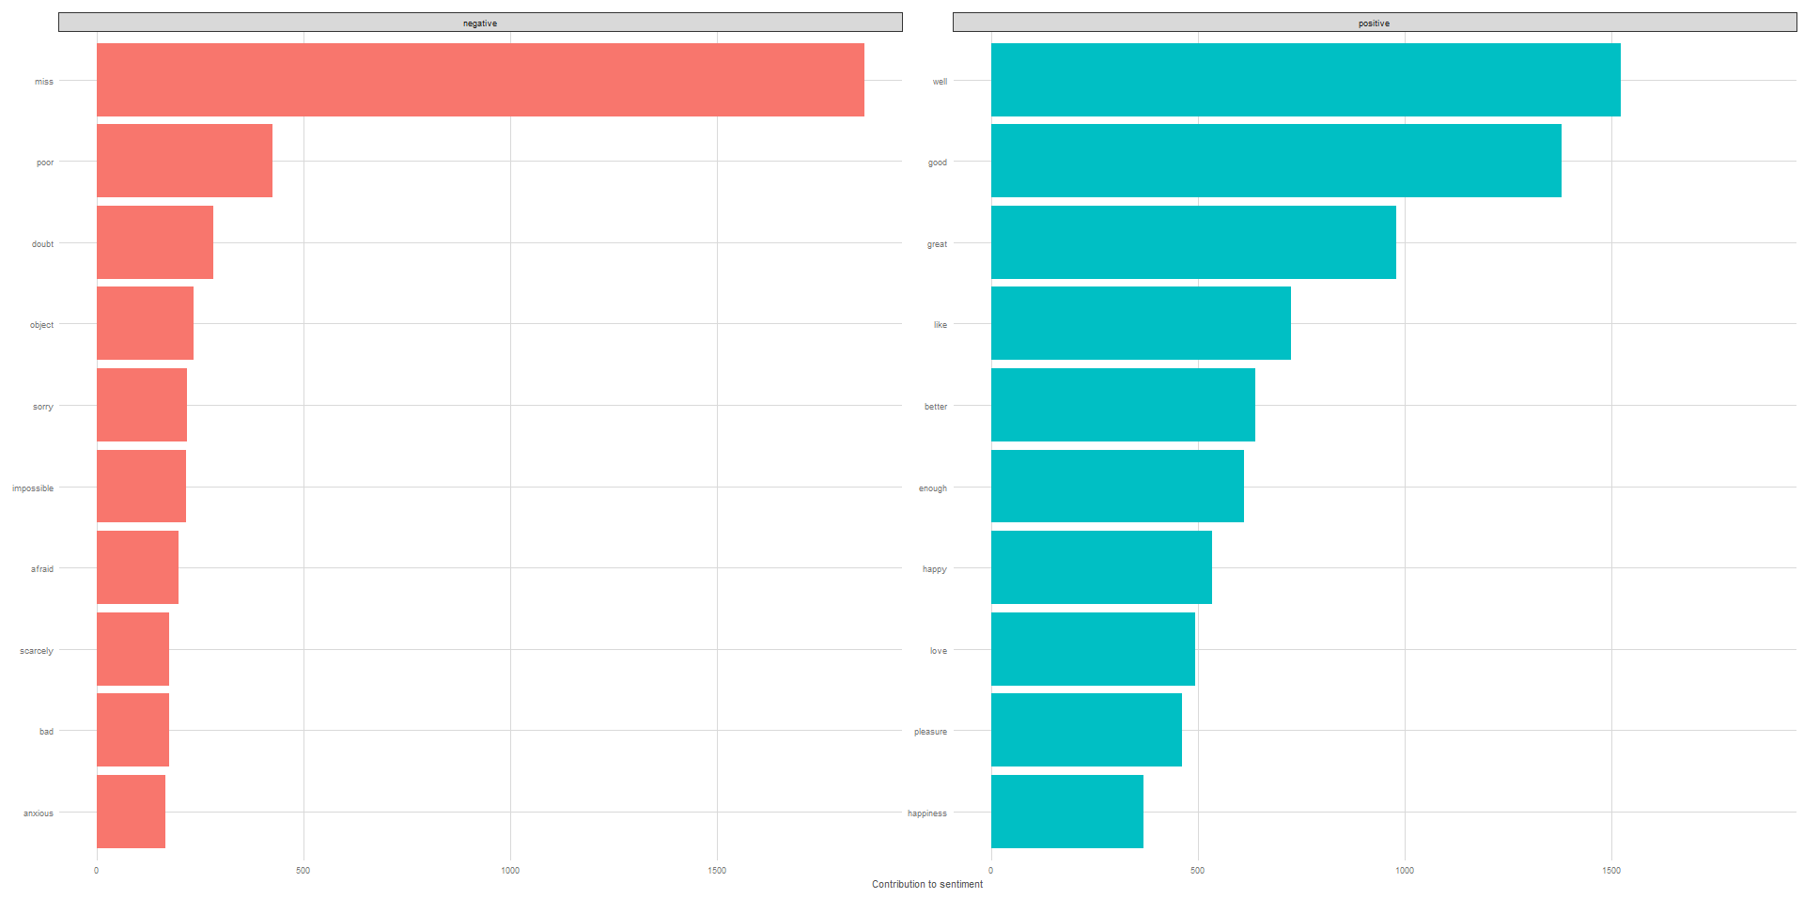

Slide 22
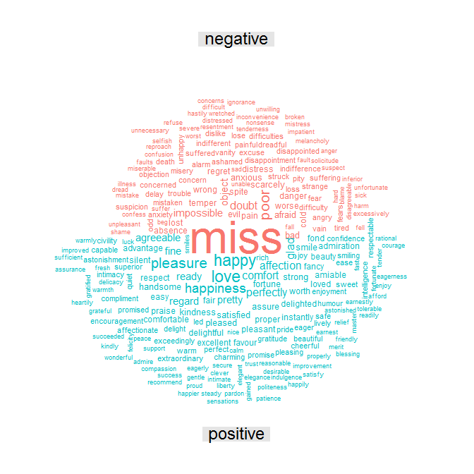

Slide 23
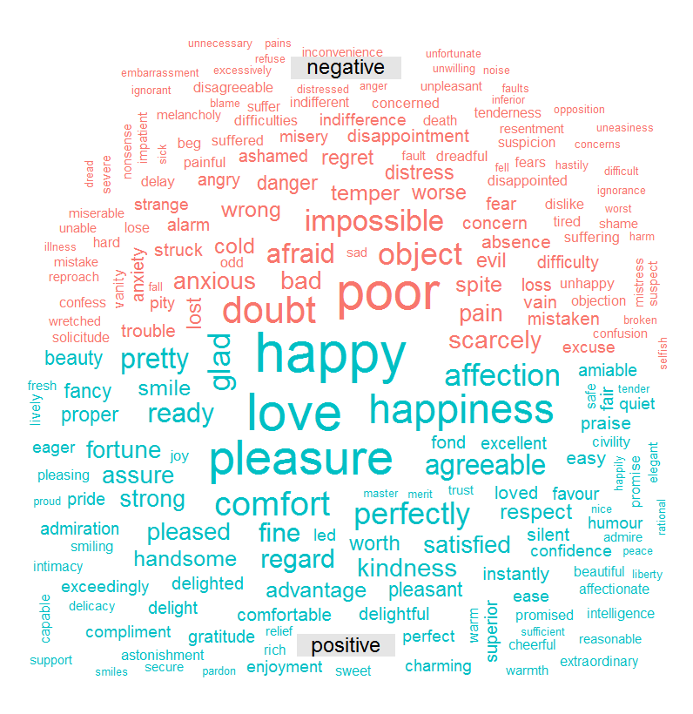

Slide 24
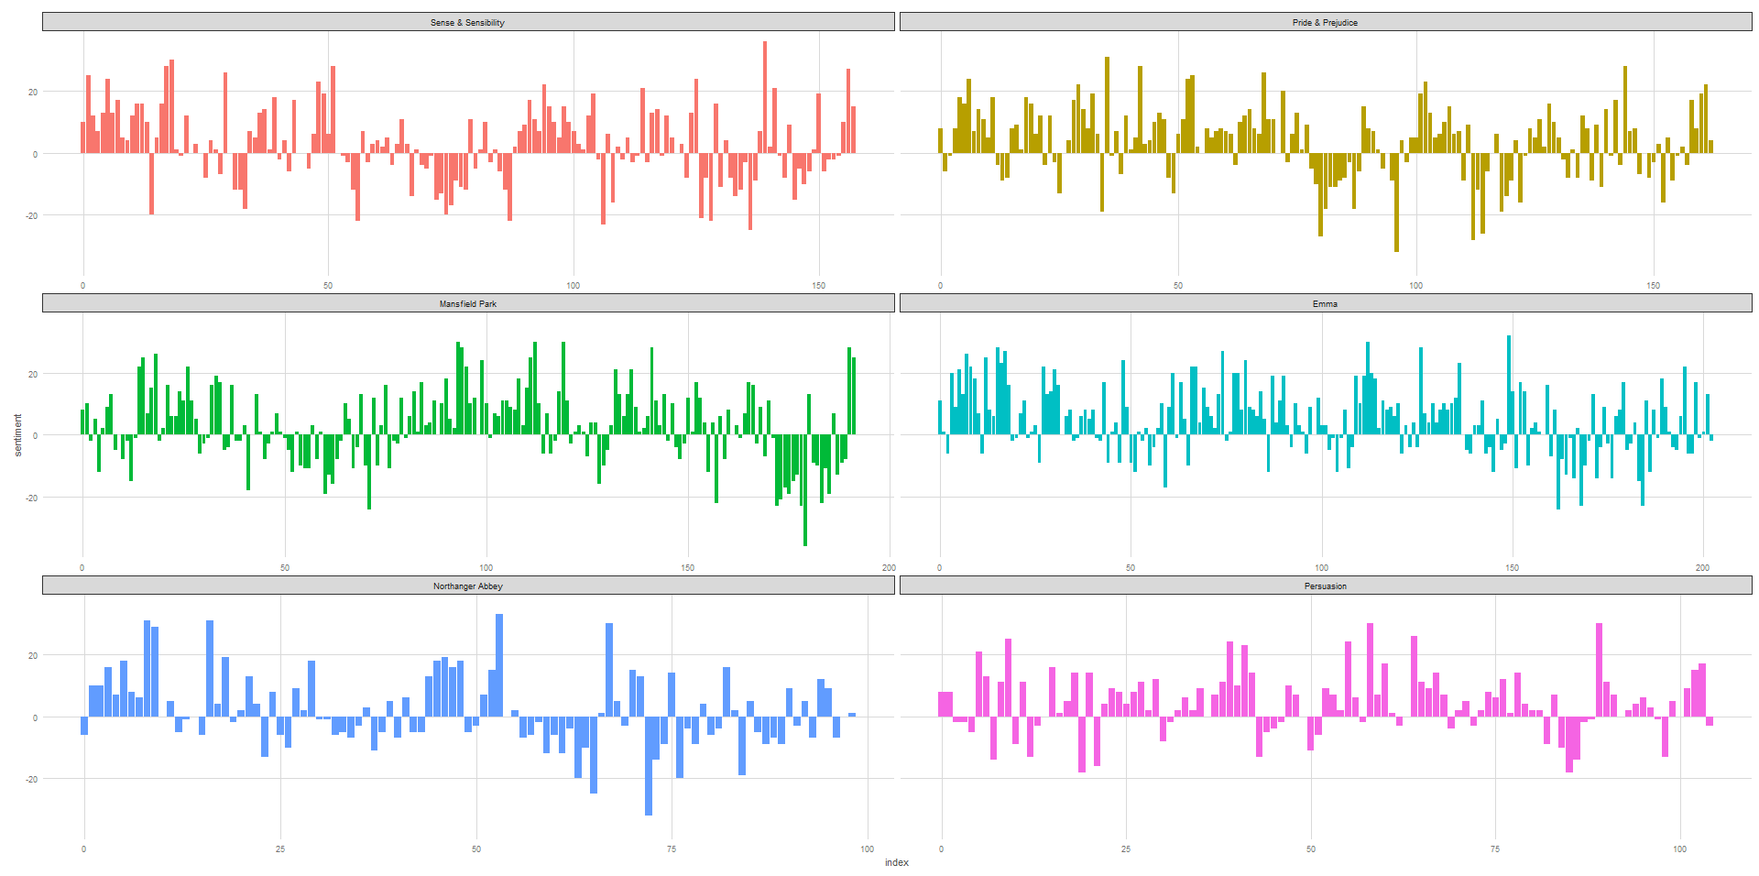

Slide 25
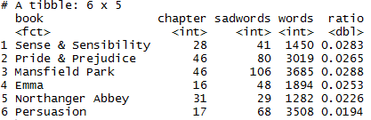
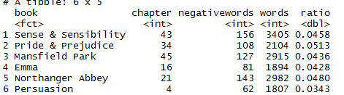
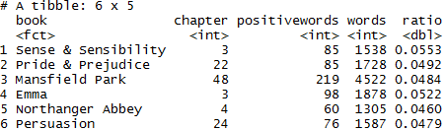

Slide 26
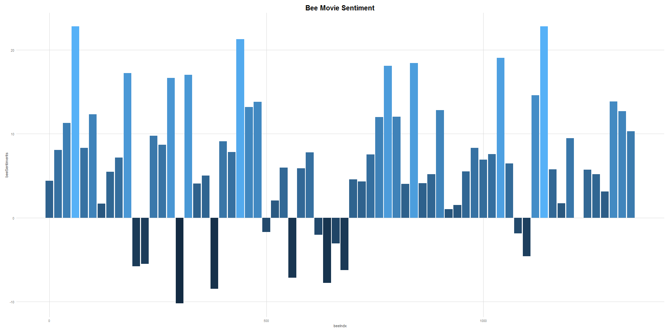

Slide 27
